Slide 1
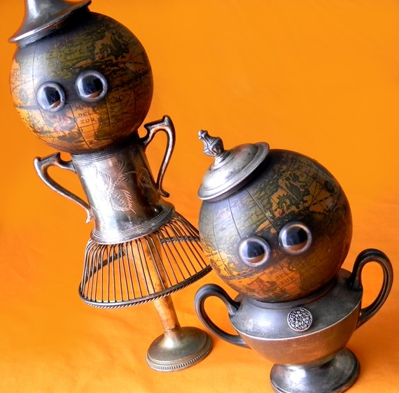



Recycled Robots
CUBS
This Photo by Unknown Author is licensed under CC BY

Slide 2
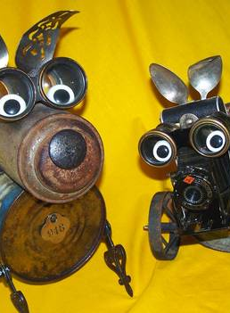
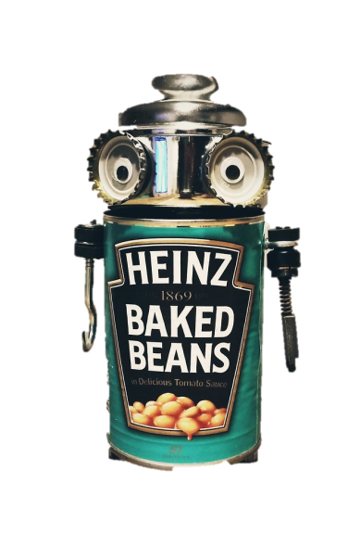
Hello little masters. I am HEBB. Extra points for any one who can work out how I got that name
My body is a clue. Don’t worry if you don’t get it I will tell you at the end
So today I am here to help you guys make some more recycled robots just like me!
I can’t wait to see what robots you guys come up with!

Slide 3
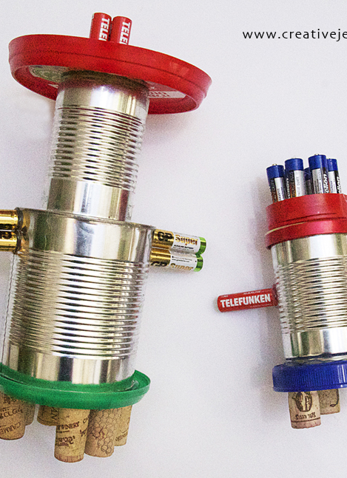
Your task is not an easy one! Using recyclable material that you find in your house you need to build a robot.
This robot will be judged on colour, usefulness, emotions and any moving parts
Who will be the judge? Why, it will be you little masters!

Slide 4
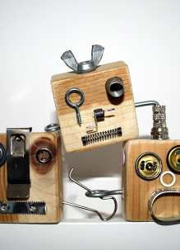
I’m going to put the rules and information down below as a reminder if you need it.
Rules
Must use recyclable material
Needs to have a name
Needs a short story telling us about the robot and what it does
Judging Criteria
Emotions
Moving parts
Usefulness
Colour
Helpful Info
Emotions – Is it angry, sad or happy maybe colour can be used here as well as facial expressions
Usefulness – what can it do? Can I store pencils in it or use it for something?
When coming up with a story let your imagination go wild! The crazier the story the better!

Slide 5
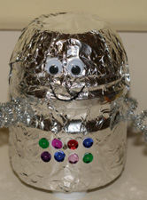
Judgement Time
So as I mentioned before, you will all judge each others robots.
The criteria is colour, usefulness, moving parts and emotion.
Oh this is going to be good. I just know it in my gut…. That is if I have a gut, do I have a gut?
You should all have a page you can write your scores on or if your smart use the chat lobby to type your answers. If using a page you will write down your score and show it to the camera when asked.
The score will be between 1 and 5 with 5 being the highest score.
Remember you cannot score your own robot.
This Photo by Unknown Author is licensed under CC BY-ND

Slide 6
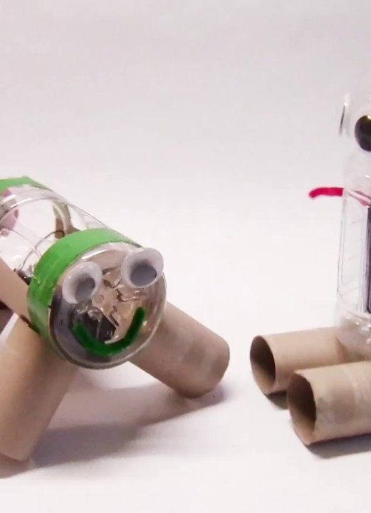
Judgement Time
Score 1 -5 with 5 being the highest. All scores will be totaled with the biggest score winning.
Can’t score your own robot
Write clearly who you are scoring and write clearly what your score is for e.g. emotions or usefulness

Slide 7
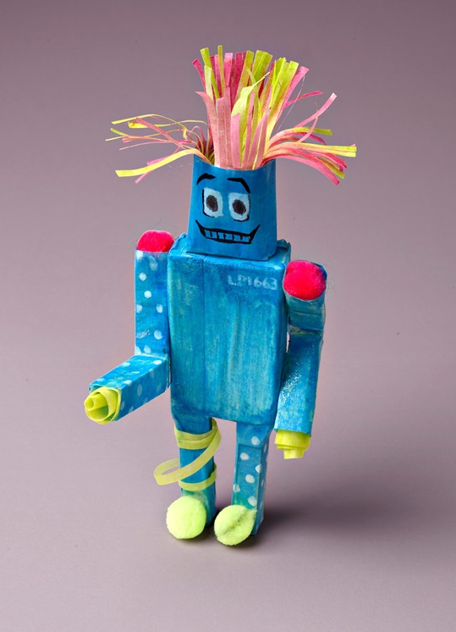
Finished
Those were some great robots! I cant believe all the different shapes, sizes and materials used.
Unfortunately it is time for me to go now and recharge my batteries but before I go did any one work out where my name came from?
HEinz
Baked
Beans
My creator thought he was being funny I’m, I’m not so sure. I think you little masters came up with much better names for your robots.
Well that’s me I am at 1% battery life so I got to go. I hope you had fun and good bye!

