Slide 1
Higher or Lower
Famous Landmarks

Slide 2
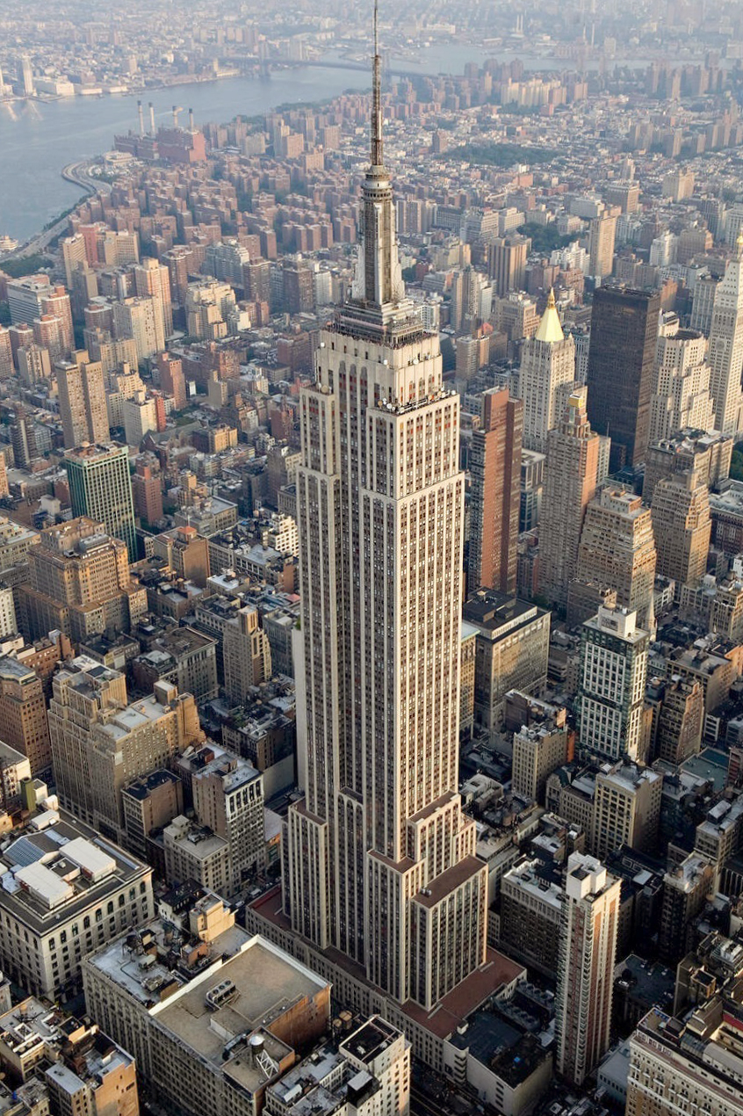
You 1st land mark is …
Empire State Building
New York
443m

Slide 3
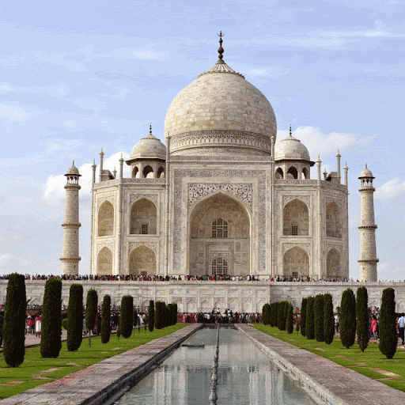
Higher or Lower?
Taj Mahal

Slide 4
Higher or Lower?
Taj Mahal
LOWER
73m

Slide 5
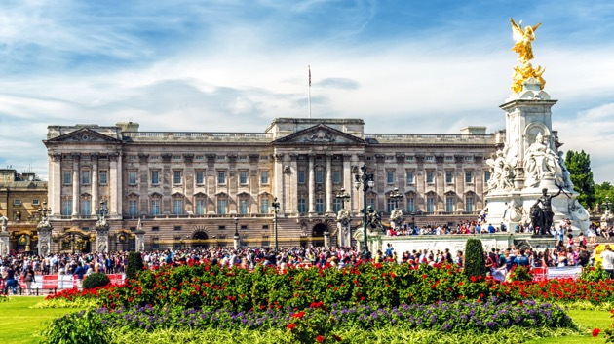
Higher or Lower?
Buckingham Palace

Slide 6
Higher or Lower?
Buckingham Palace
LOWER
24m

Slide 7
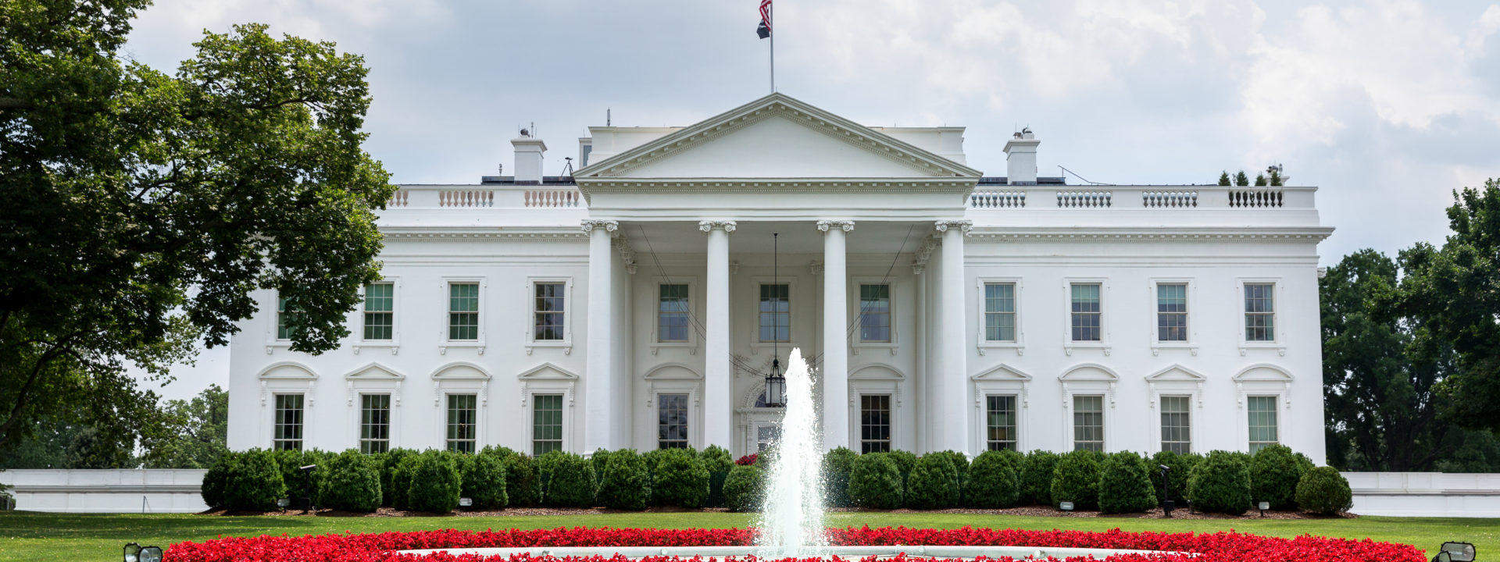
Higher or Lower?
White House

Slide 8
Higher or Lower?
White House
LOWER
21m

Slide 9
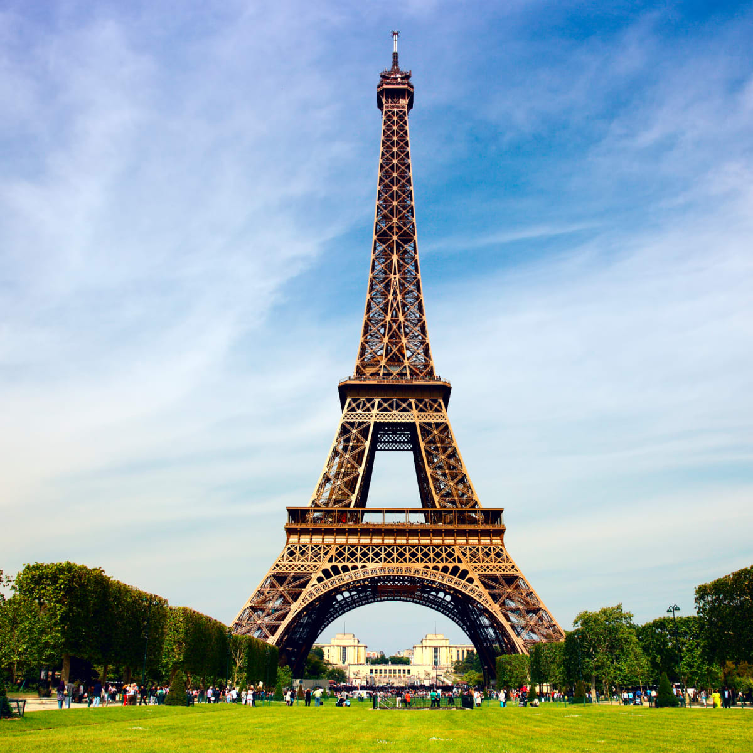
Higher or Lower?
Eiffel Tower

Slide 10
Higher or Lower?
Eiffel Tower
HIGHER
324m

Slide 11
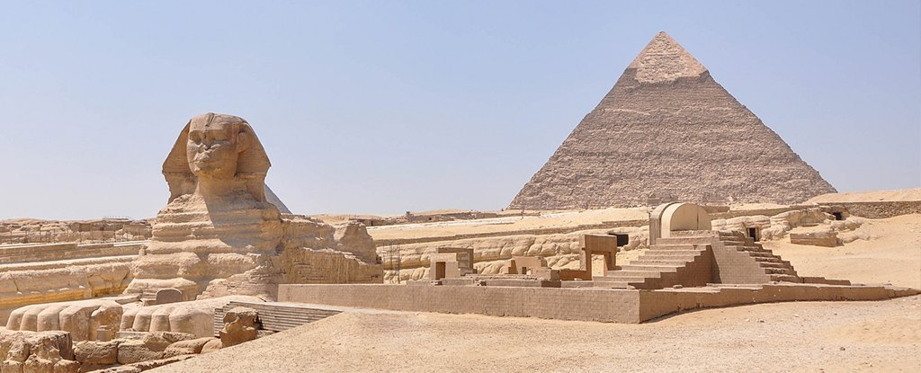
Higher or Lower?
Great Pyramid of Giza

Slide 12
Higher or Lower?
Great Pyramid of Giza
LOWER
139m

Slide 13
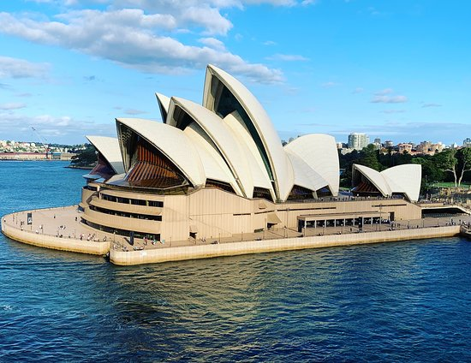
Higher or Lower?
Sydney Opera House

Slide 14
Higher or Lower?
Sydney Opera House
LOWER
65m

Slide 15
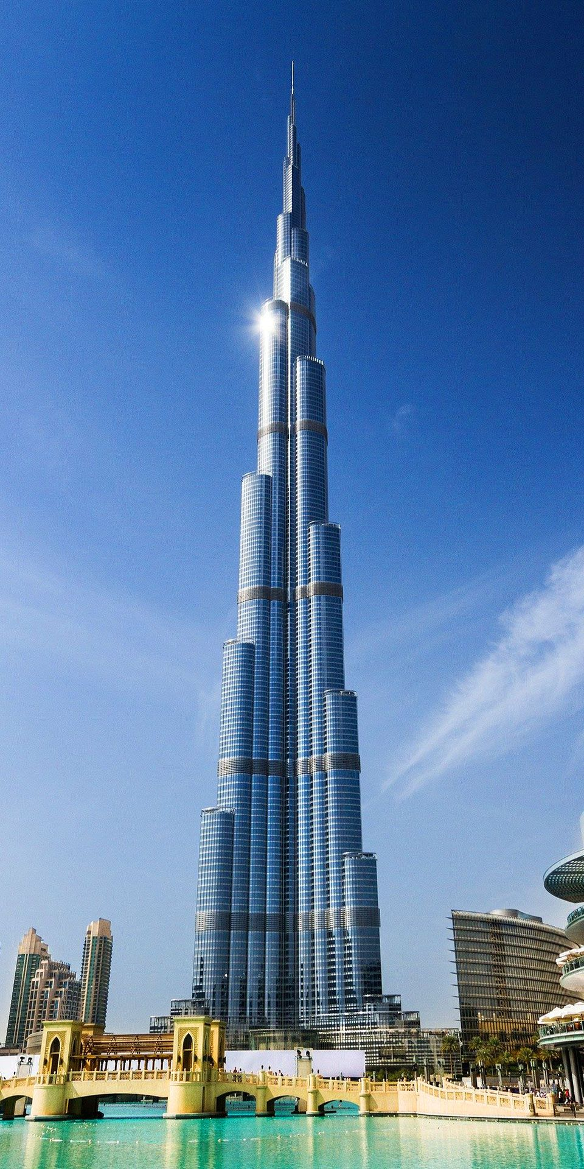
Higher or Lower?
Burj Kalife
Dubai

Slide 16
Higher or Lower?
Burj Kalife
Dubai
HIGHER
830m

Slide 17
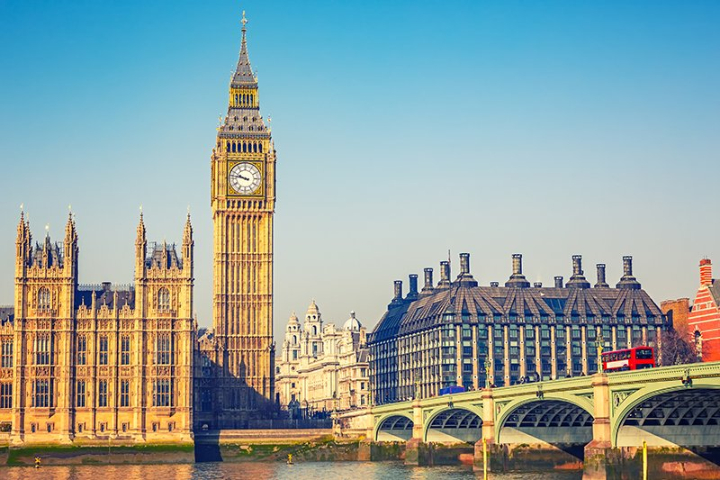
Higher or Lower?
Big Ben

Slide 18
Higher or Lower?
Big Ben
LOWER
96m

Slide 19
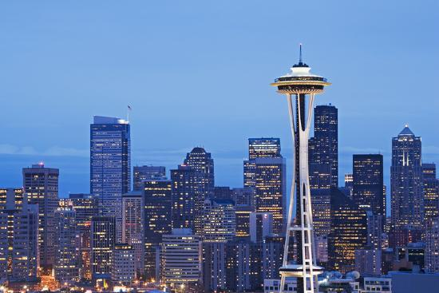
Higher or Lower?
Space Needle
Seattle

Slide 20
Higher or Lower?
Space Needle
Seattle
HIGHER
184m

Slide 21
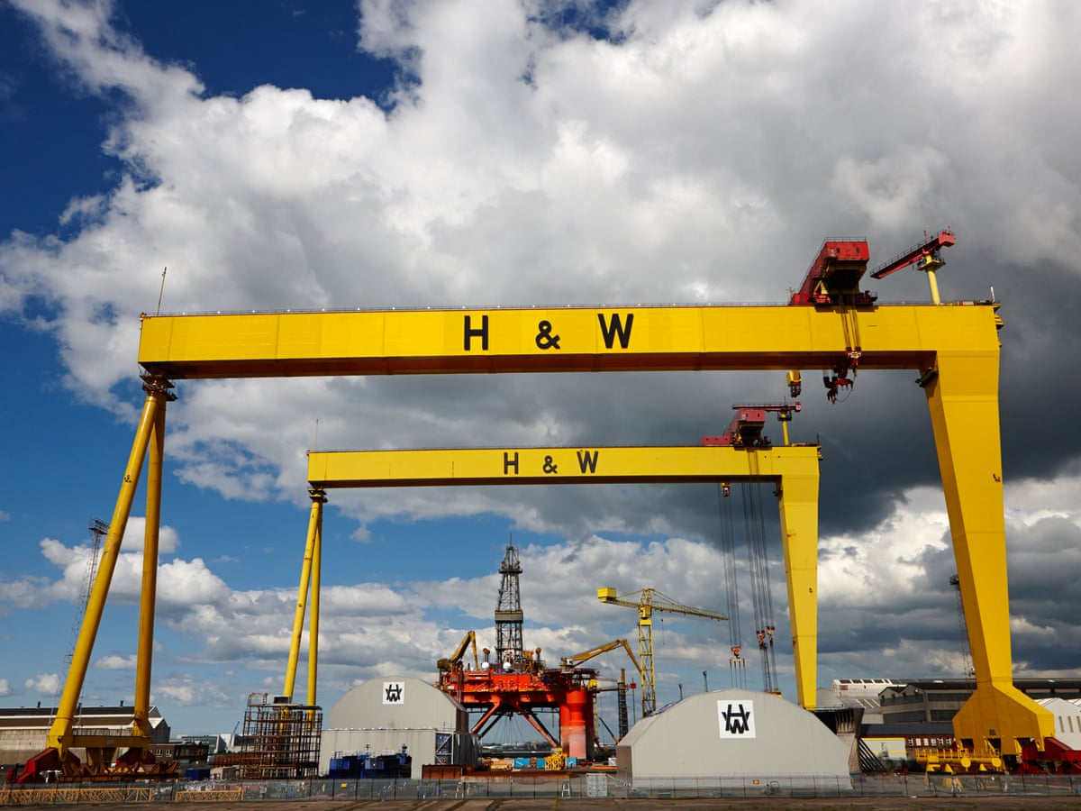
Higher or Lower?
Harland and Wolff Cranes

Slide 22
Higher or Lower?
Harland and Wolff Cranes
LOWER
106m

Slide 23
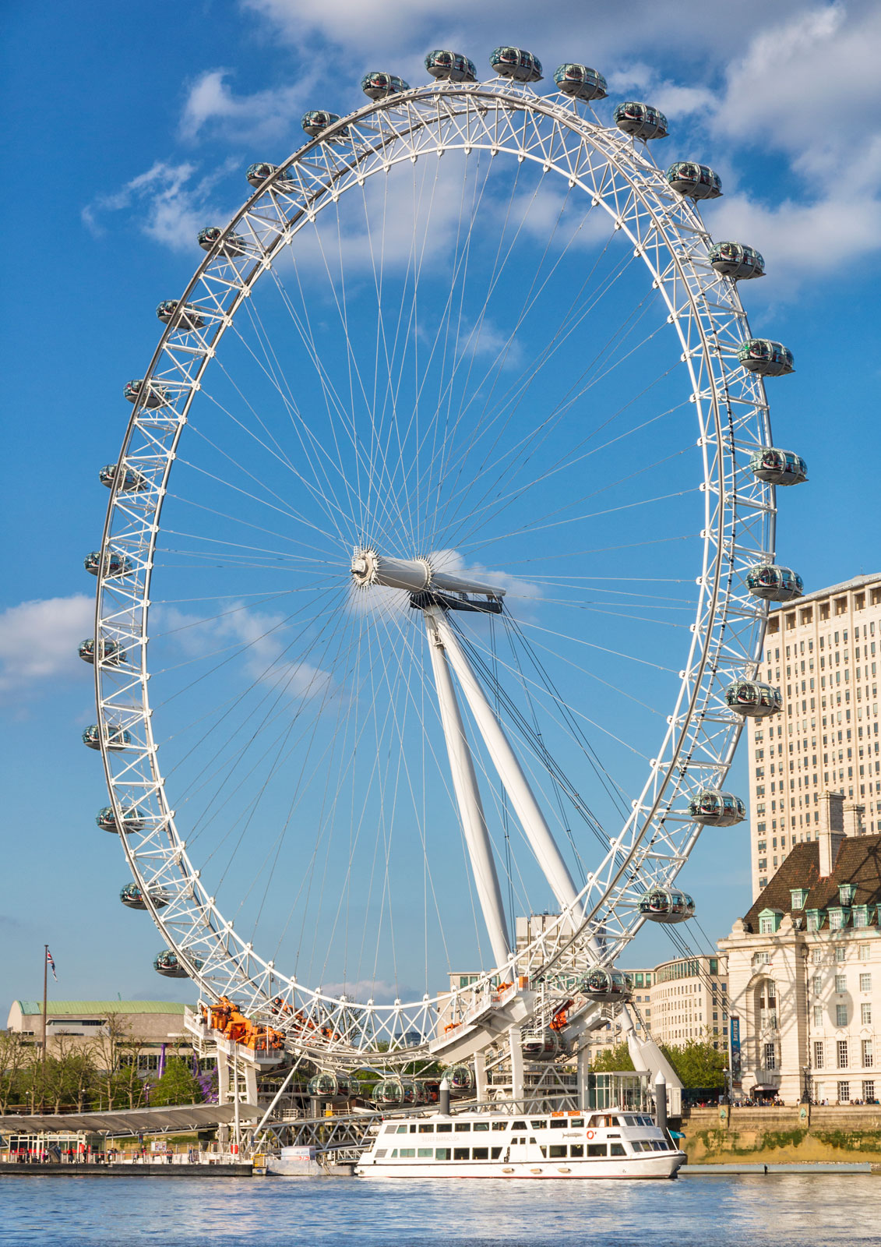
Higher or Lower?
London Eye

Slide 24
Higher or Lower?
London Eye
HIGHER
135m

Slide 25
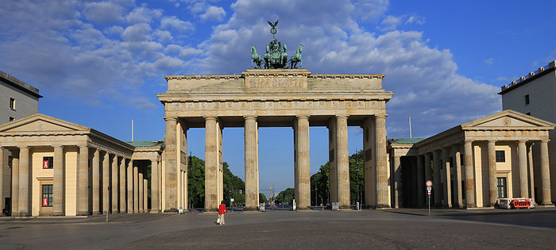
Higher or Lower?
Brandenburg Gate
Berlin

Slide 26
Higher or Lower?
Brandenburg Gate
Berlin
LOWER
26m

Slide 27
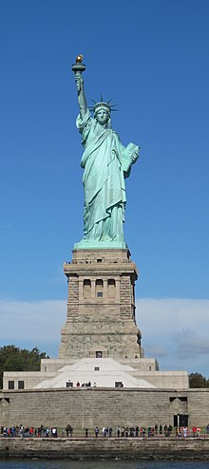
Higher or Lower?
Statue of Liberty
New York

Slide 28
Higher or Lower?
Statue of Liberty
New York
HIGHER
93m

Slide 29
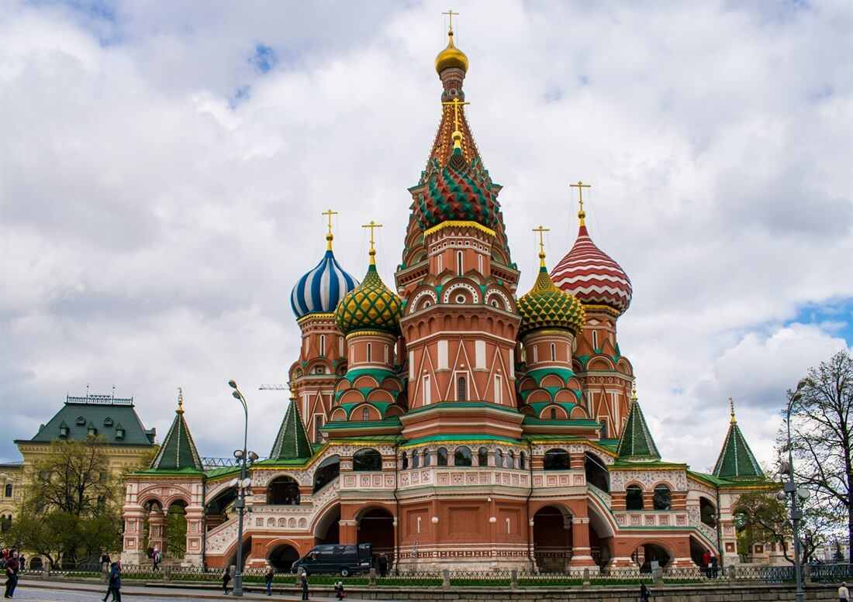
Higher or Lower?
St Basils Cathedral
Moscow, Russia

Slide 30
Higher or Lower?
St Basils Cathedral
Moscow, Russia
LOWER
63m

Slide 31
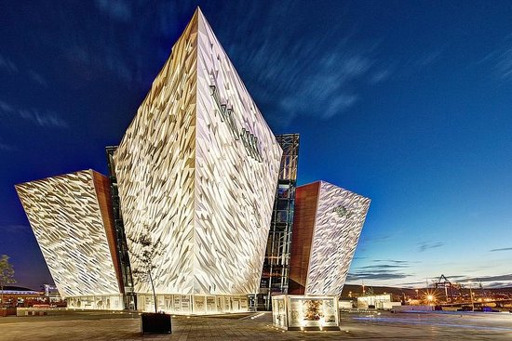
Higher or Lower?
Titanic Museum
Belfast

Slide 32
Higher or Lower?
Titanic Museum
Belfast
LOWER
38m

Slide 33
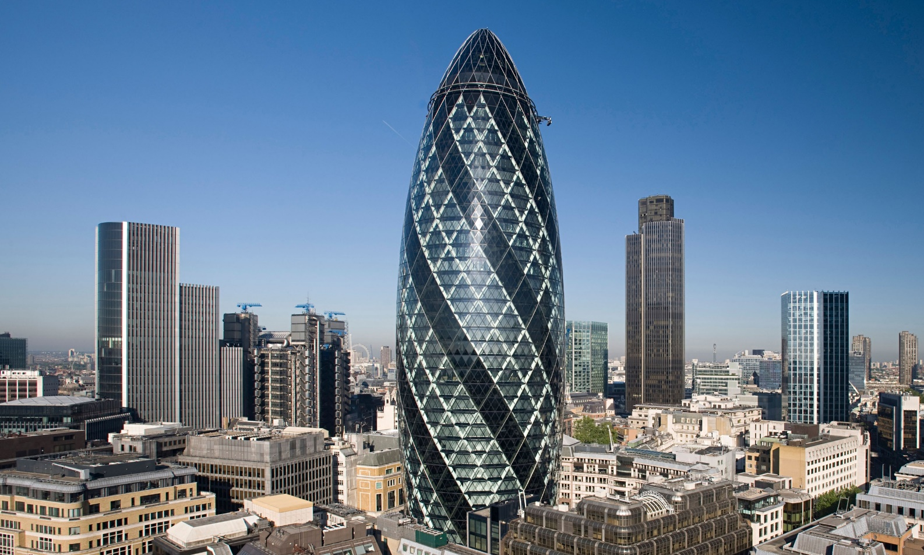
Higher or Lower?
The Gherkin
London

Slide 34
Higher or Lower?
The Gherkin
London
HIGHER
180m

Slide 35
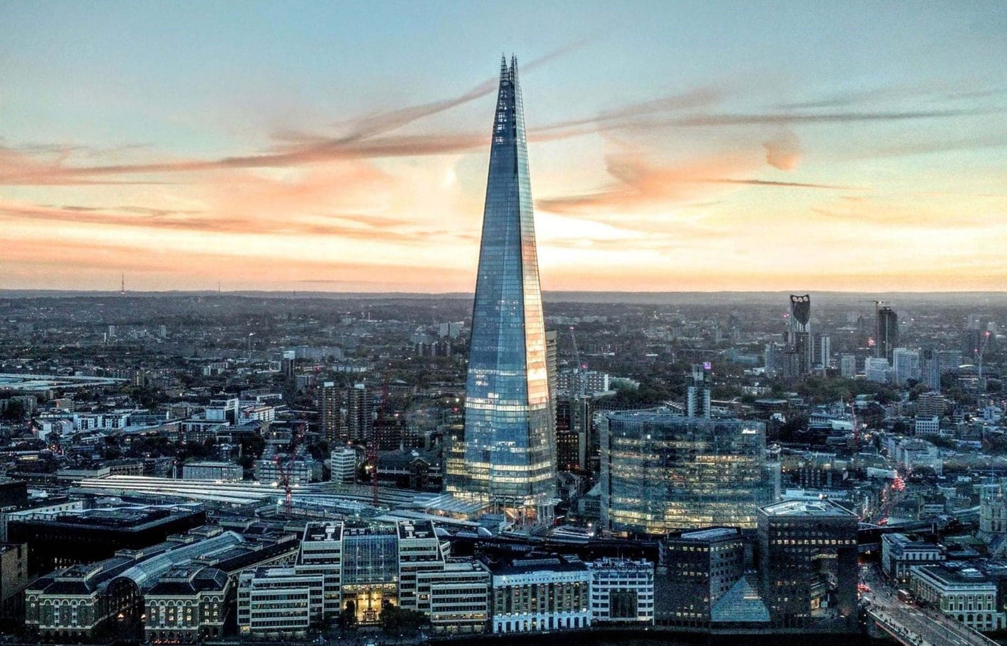
Higher or Lower?
The Shard
London

Slide 36
Higher or Lower?
The Shard
London
HIGHER
310m

Slide 37
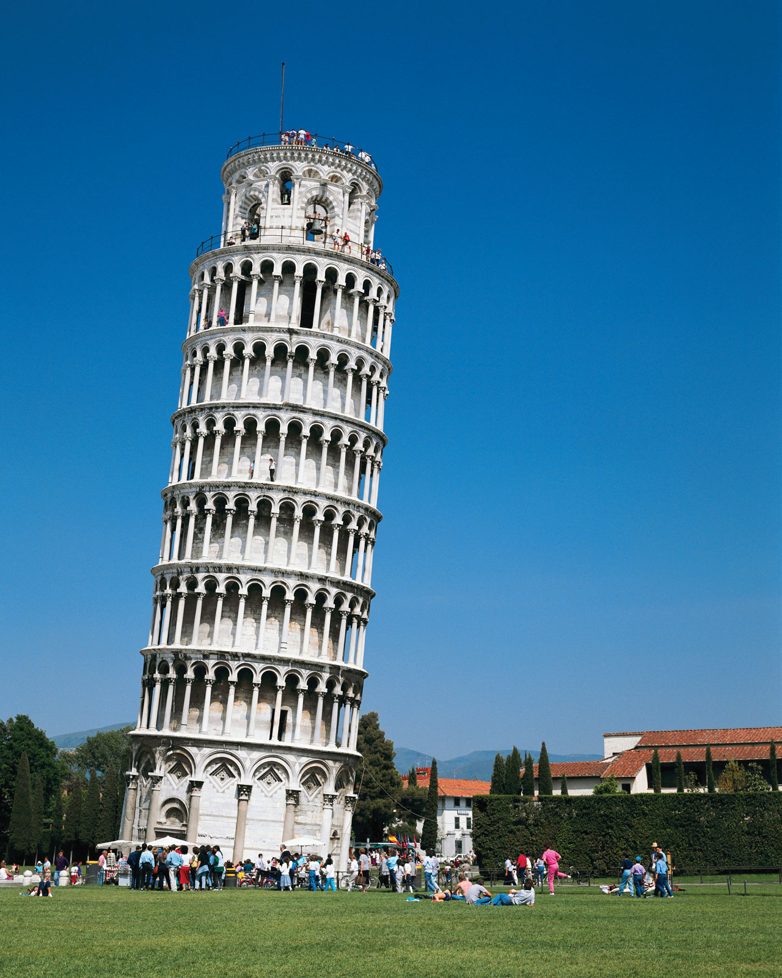
Higher or Lower?
The Leaning
Tower of Pisa

Slide 38
Higher or Lower?
The Leaning
Tower of Pisa
LOWER
57m

Slide 39
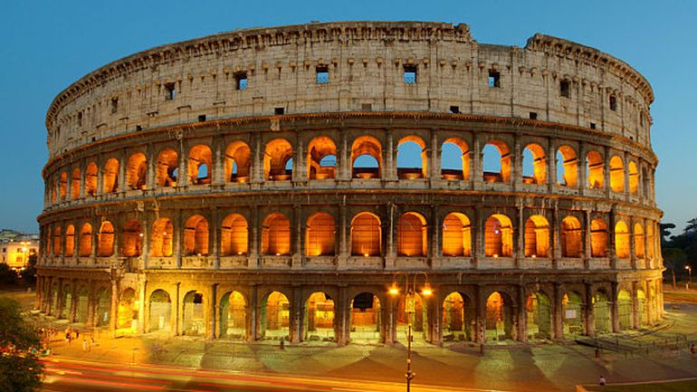
Higher or Lower?
The Colosseum

Slide 40
Higher or Lower?
The Colosseum
LOWER
48m

Slide 41

How well did you do?

