Slide 1
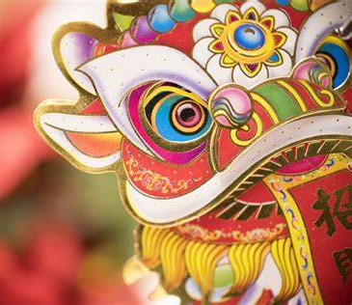
Welcome Scouts
欢迎

Slide 2
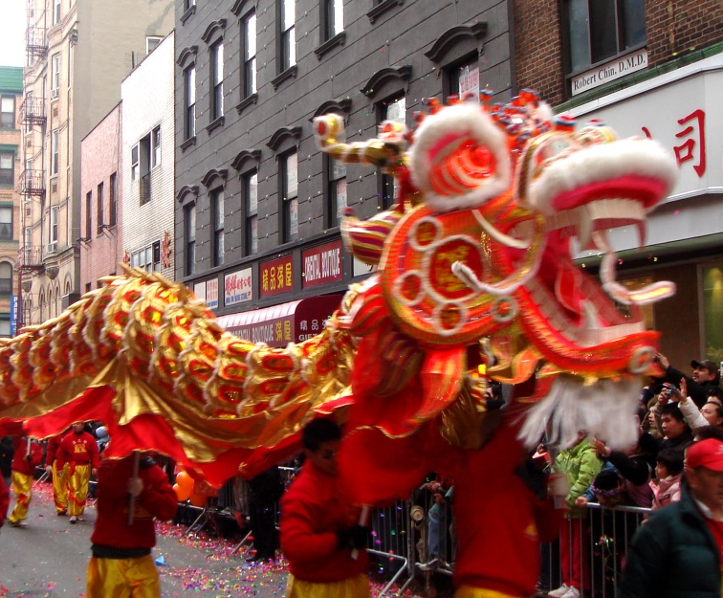
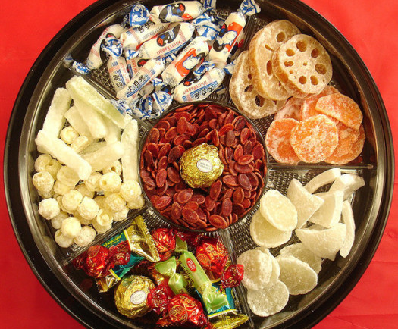
What is Chinese New Year?
You’re about to find out! Pay close attention as there may be a quiz !!
Chinese New Year is the most important holiday in China. In 2021, Chinese New Year will begin on February 12, tied to the Chinese lunar calendar.
The holiday was traditionally a time to honour household and heavenly deities (God/ Goddess) as well as ancestors. It was also a time to bring family together for feasting.
Although many Chinese people living in the West join in celebrating January 1 as New Year’s Day, China however, continues to celebrate the Chinese New Year and uses the traditional greeting, “Kung hei fat choi.”

Slide 3
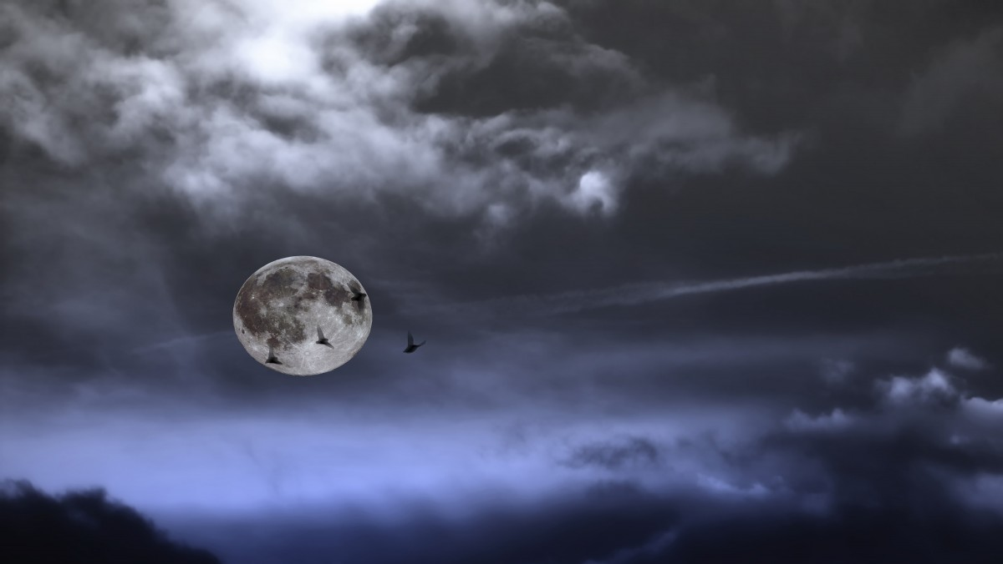
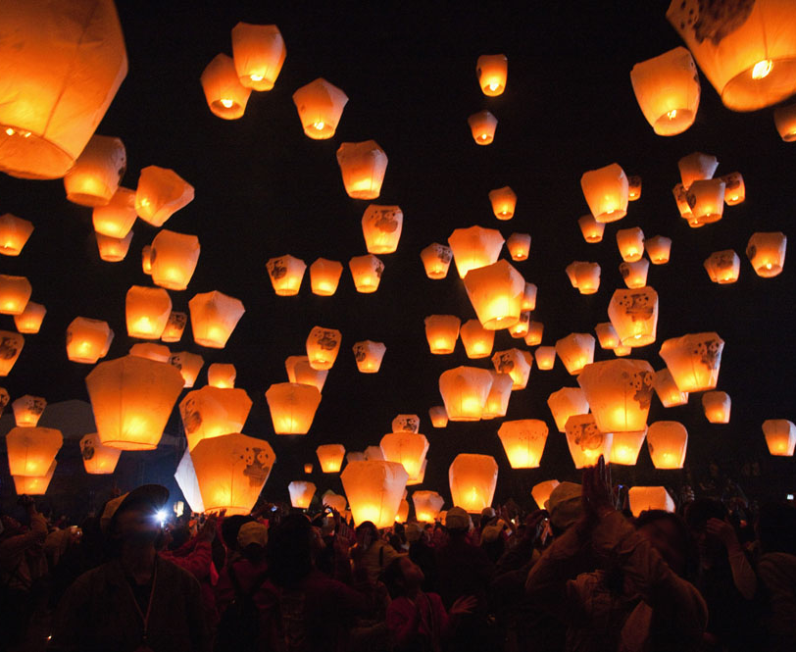
When is the Chinese New Year?
Chinese New Year typically begins with the new moon that occurs between the end of January and the end of February, and it lasts about 15 days, until the full moon arrives with the Festival of Lanterns.

Slide 4
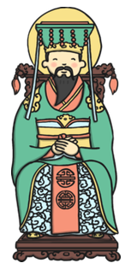
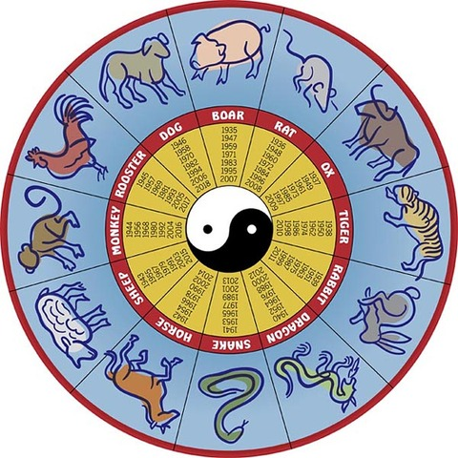
2021 is the Chinese year of the OXEN
The ancient Chinese lunar calendar, on which Chinese New Year is based, functioned as a religious, dynastic and social guide. Records indicate that the calendar existed as early as 14th century B.C., when the Shang Dynasty was in power.
The calendar was changeable and was reset according to which emperor held power and varied from one region to another.
The Chinese calendar was a complex timepiece. Its parameters were set according to the lunar phases as well as the solar solstices and equinoxes. Yin and yang, the opposing but complementary principles that make up a harmonious world, also ruled the calendar.

Slide 5
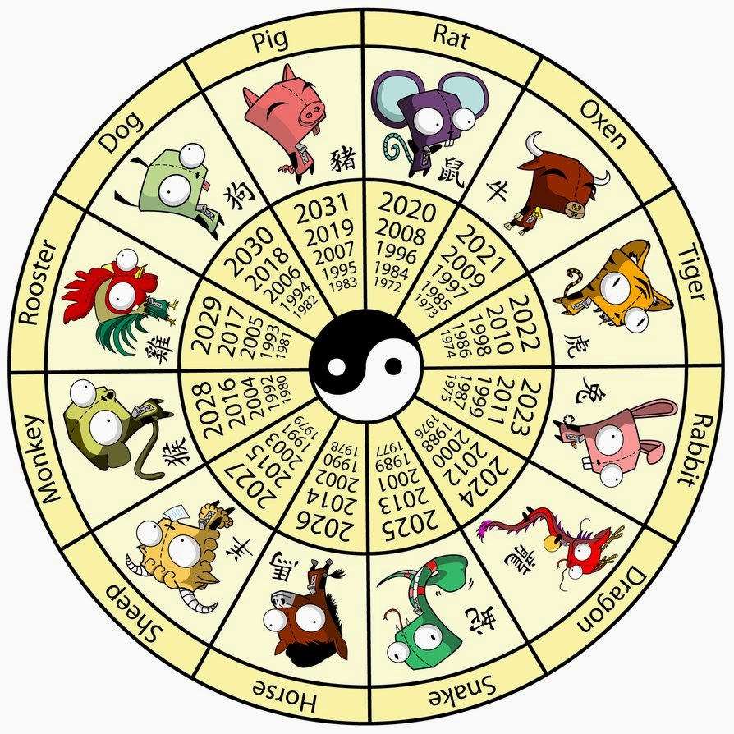
Chinese New Year Animals
The Chinese calendar also includes the Chinese zodiac, which is a cycle of twelve stations or “signs” which change depending on the Sun.
Each new year was marked by the characteristics of one of the 12 zodiac animals:
The rat, ox, tiger, rabbit, dragon, snake, horse, sheep, monkey, rooster, dog and pig.
This is the year of the Oxen
Look for your year of Birth to see which Zodiac animal you are?

Slide 6
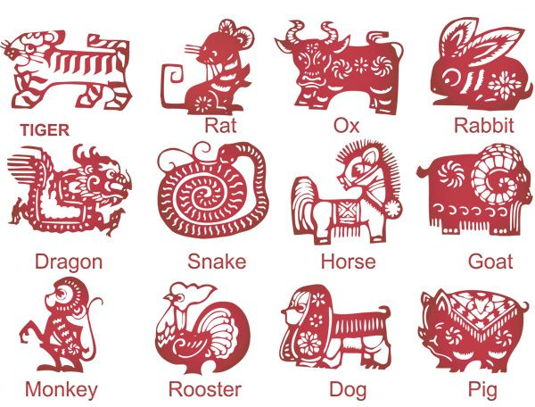
Animal Personalities
Rat | Quick-witted, smart, charming, persuasive
Ox | Patient, kind, stubborn, conservative
Tiger | Authoritative, emotional, courageous, intense
Rabbit | Popular, compassionate, sincere
Dragon | Energetic, fearless, warm-hearted, charismatic
Snake | Charming, gregarious, introverted, generous, smart
Horse | Energetic, independent, impatient, enjoys travelling
Sheep | Mild-mannered, shy, kind, peace loving
Monkey | Fun, energetic, active
Rooster | Independent, practical, hardworking, observant
Dog | Patient, diligent, patient, generous, faithful, kind
Pig | Loving , tolerant, honest, appreciates luxury

Slide 7
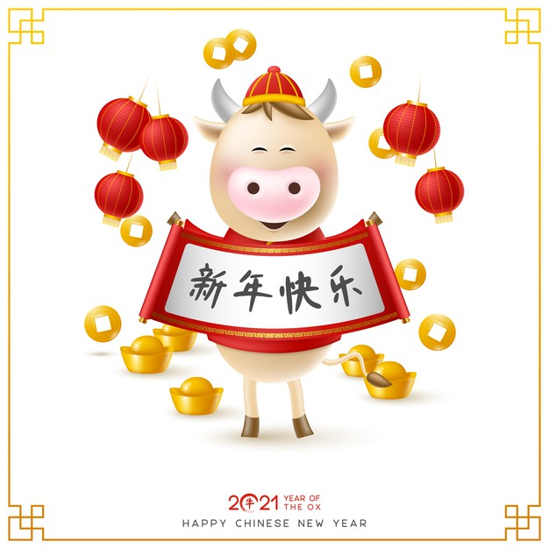
Ready for a Quiz?
準備進行測驗嗎？
Zhǔnbèi jìnxíng cèyàn ma?

Slide 8
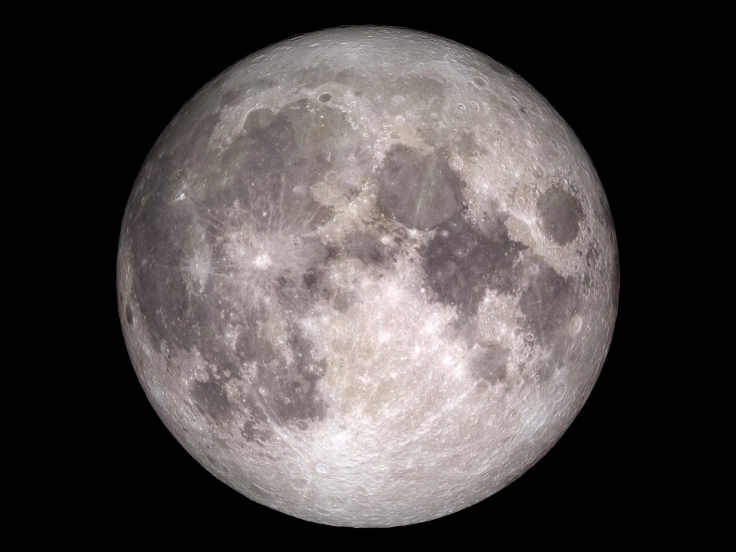
The Lunar calendar is traditionally used amongst a lot of cultures across the world. What is this calendar based on?
The Sun
The Stars
The Moon
The lunar calendar is based on cycles of the moon.

Slide 9
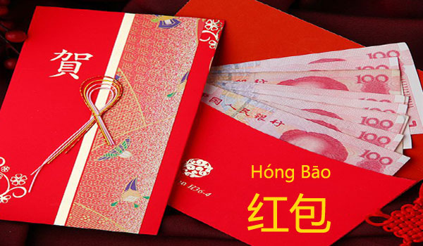
At Lunar New Year, some Chinese families give out traditional red envelopes with money in to their loved ones. Why are the envelopes red?
They’re the most common types of envelopes in China
You cant see through red paper
Red is a Lucky Colour in China
Money is given to family and close friends in envelopes made of red paper, which symbolises good luck and fortune. Decorating homes with red lanterns is also said to bring good luck to the home.

Slide 10

In the Chinese calendar, each year is represented by one of twelve animals. 2020 is the year of the rat, but which of these animals doesn’t feature in the Chinese zodiac?
Dog
Dragon
Duck
The Chinese zodiac doesn’t feature a duck. The animals of the zodiac are a rat, ox, tiger, rabbit, dragon, snake, horse, ram, monkey, rooster, dog, and pig.

Slide 11
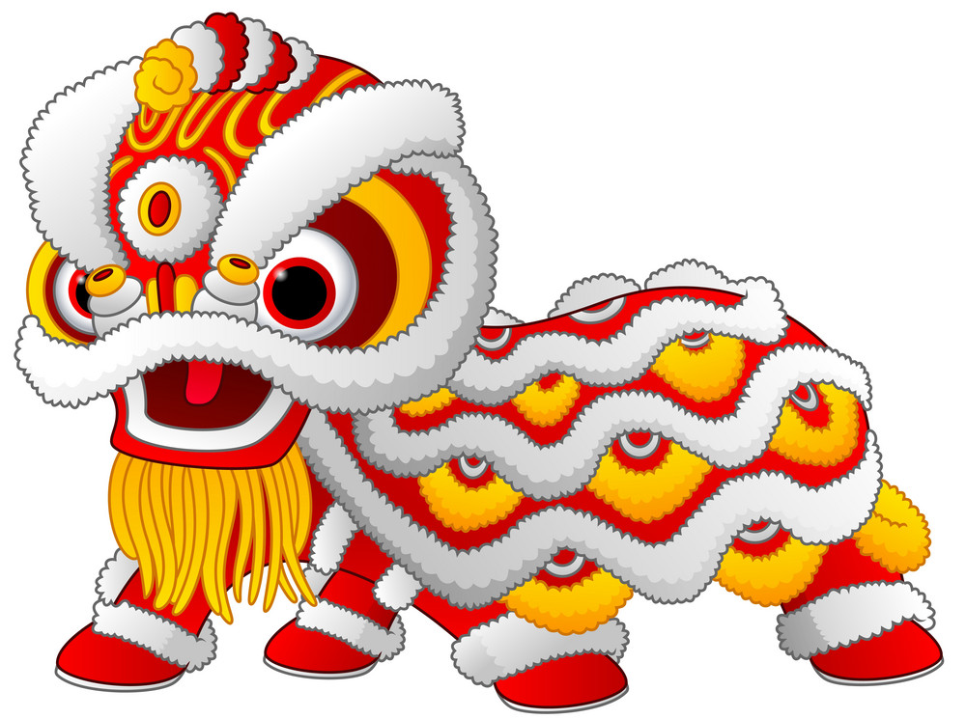
The Chinese New Year celebrations last for more than one day but how many?
28
17
15
The celebrations last for 15 Days.

Slide 12
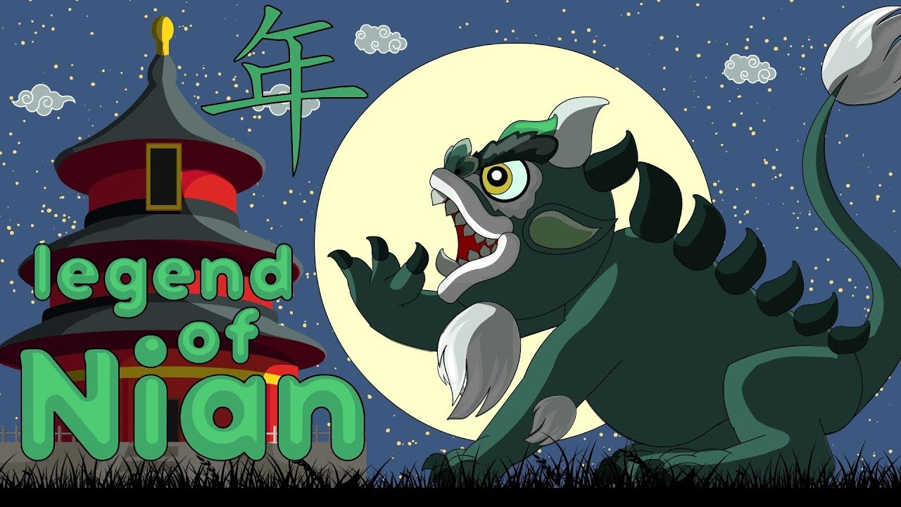
It is a Chinese tradition to light fireworks. Aside from using them to celebrate, they are used to do what?
To clear snow from the mountains
To drive away the evil
To make the air smell nice
According to old legend, burning bamboo would create loud noises that scared away a monster called Nián. This developed the tradition of using fireworks to create the loud noises and bright lights needed to keep evil spirits away.

Slide 13
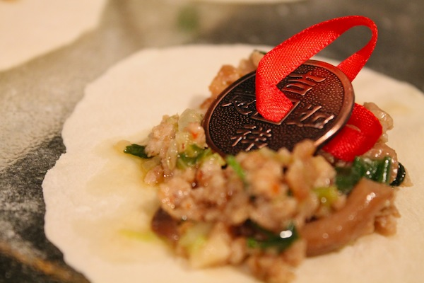
Food is a big part of Chinese New Year, and most families look forward to sharing a big meal together. Traditionally, what would make one of the diners luckier than others?
Getting the last serving
Finding a coin in their dumpling
Finding the largest fish
The old Chinese tradition of hiding a coin inside one of the New Years Eve dumplings is said to bring the one who finds it good luck, although it’s not a common thing to do now.

Slide 14
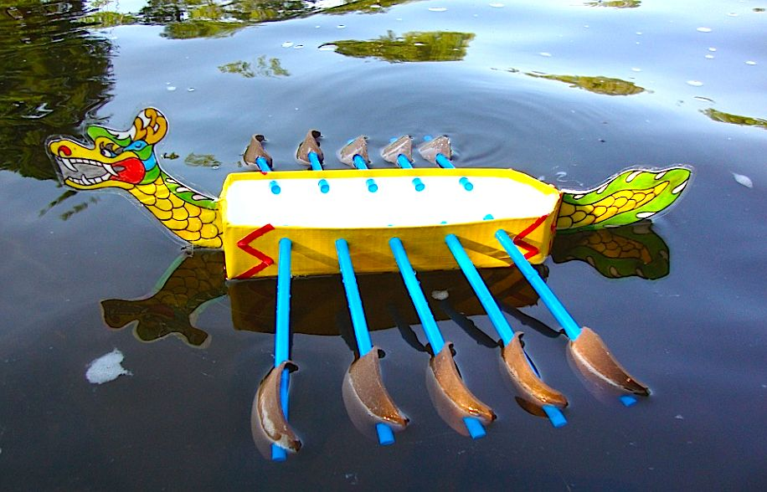
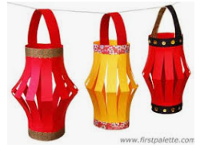
Activity Time - Craft
Click and Choose from:
Royal Navy Dragon Boat Challenge
Or
Paper Chinese Lantern

Slide 15
Paper Chinese Lantern
What do we need
A4 sheet of paper or old wallpaper of the same size
Scissors
Tape
Ruler
Pen or pencil

Slide 16

Paper Chinese Lantern
Start with rectangular sheet of paper. Cut a strip of paper from the long edge of the paper (about 1" width). This will be used as the handle of the lantern.
Note be careful when using Scissors

Slide 17
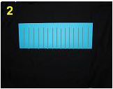
Paper Chinese Lantern
Fold the paper in half lengthwise. Cut strips crosswise: cut from the folded edge towards the raw edge. Be careful to keep the strips connected and do not cut each strip off.
Note be careful when using Scissors

Slide 18

Paper Chinese Lantern
Unfold the paper.

Slide 19

Paper Chinese Lantern
Loop the paper around to form a tube. Join the short ends of the paper together with tape.

Slide 20
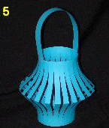
Paper Chinese Lantern
Tape or staple on the handle made in step 1 and you're done! You can make many of them and string them together - use a small piece of tape to keep them equal distance from one another.
You can also decorate them any way you like
Skip to the end

Slide 21
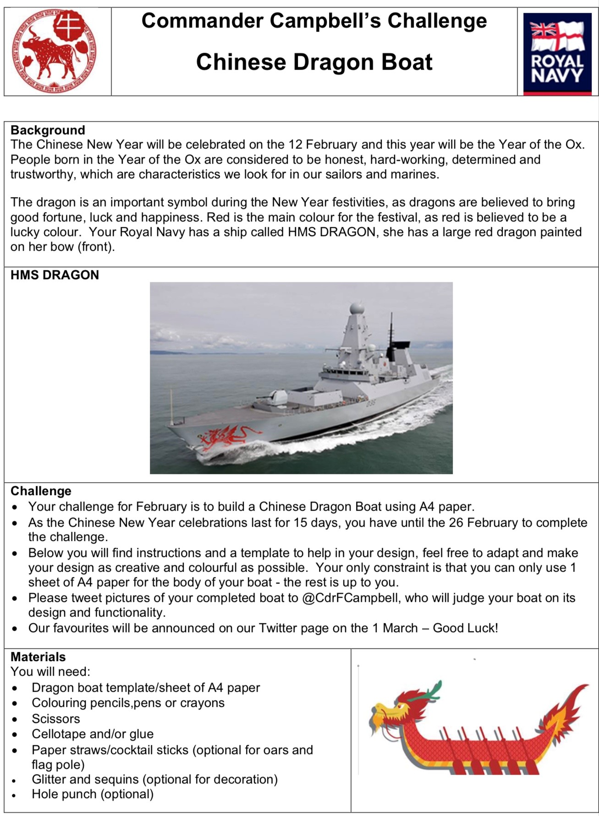
Royal Navy Dragon Boat Challenge

Slide 22
Royal Navy Dragon Boat The Challenge!

Slide 23
Royal Navy Dragon Boat Challenge
What do we need
Dragon Boat Template/ sheet of A4 paper
Colouring pencils or crayons
Scissors
Tape and or glue
Paper straws/cocktail sticks (optional for oars and flag pole)
Glitter and sequins (optional for decoration)Hole punch (optional)

Slide 24
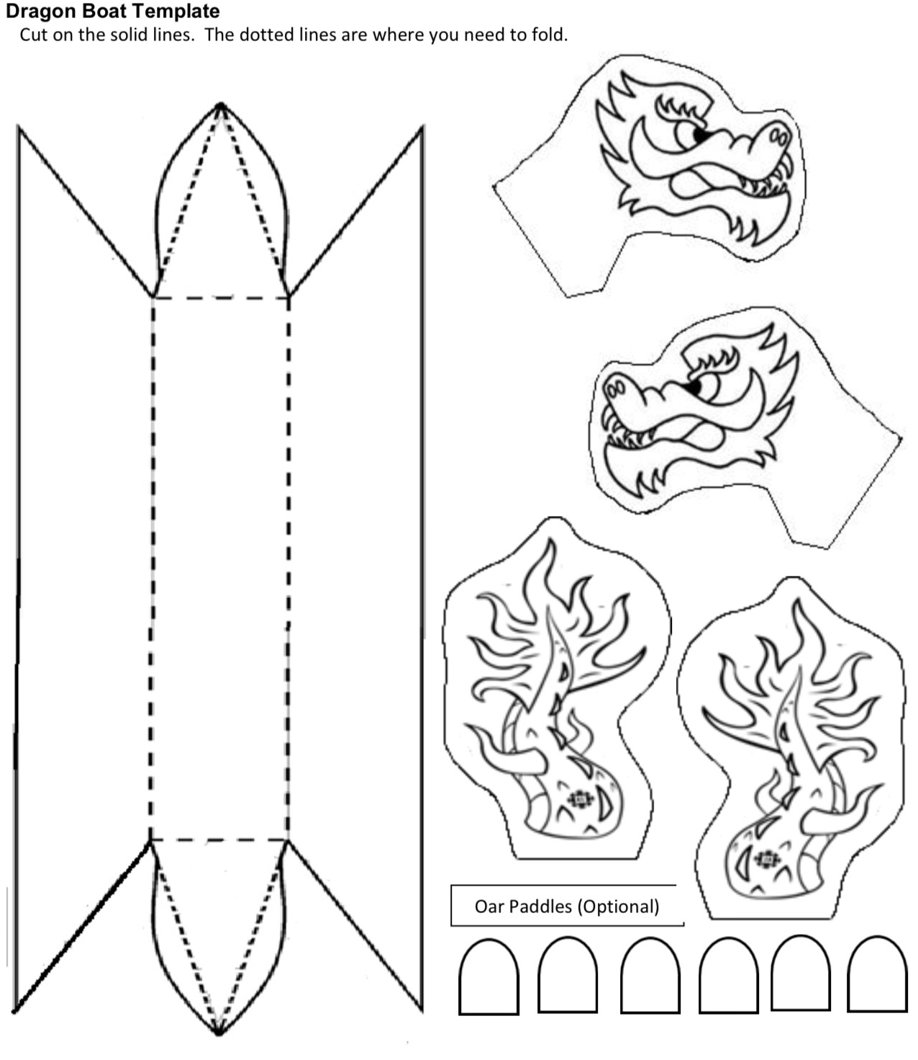
Royal Navy Dragon Boat Challenge
This is the template or deign you will need to print or draw for your dragon boat.

Slide 25
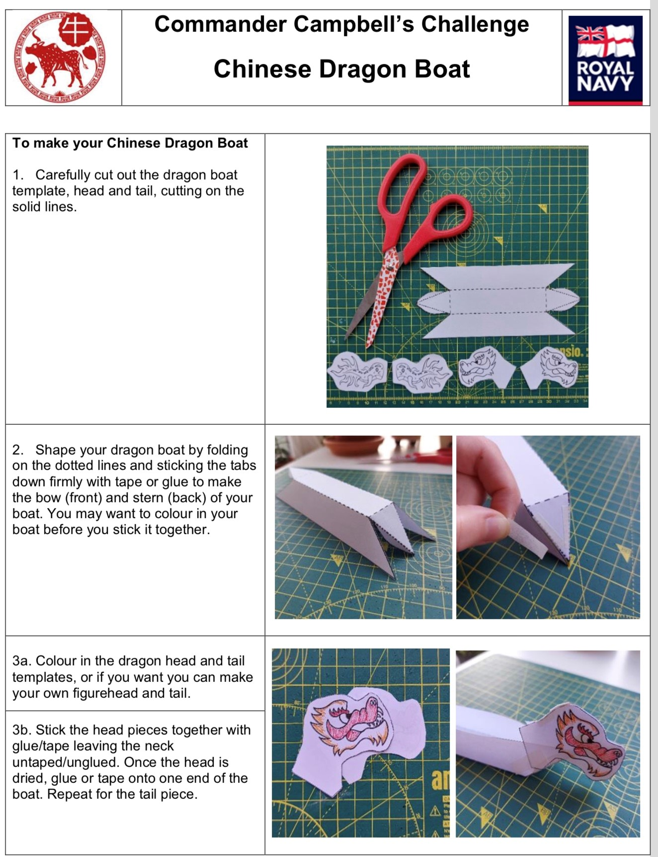
Royal Navy Dragon Boat Challenge

Slide 26
Royal Navy Dragon Boat Challenge

Slide 27
Royal Navy Dragon Boat Challenge

Slide 28
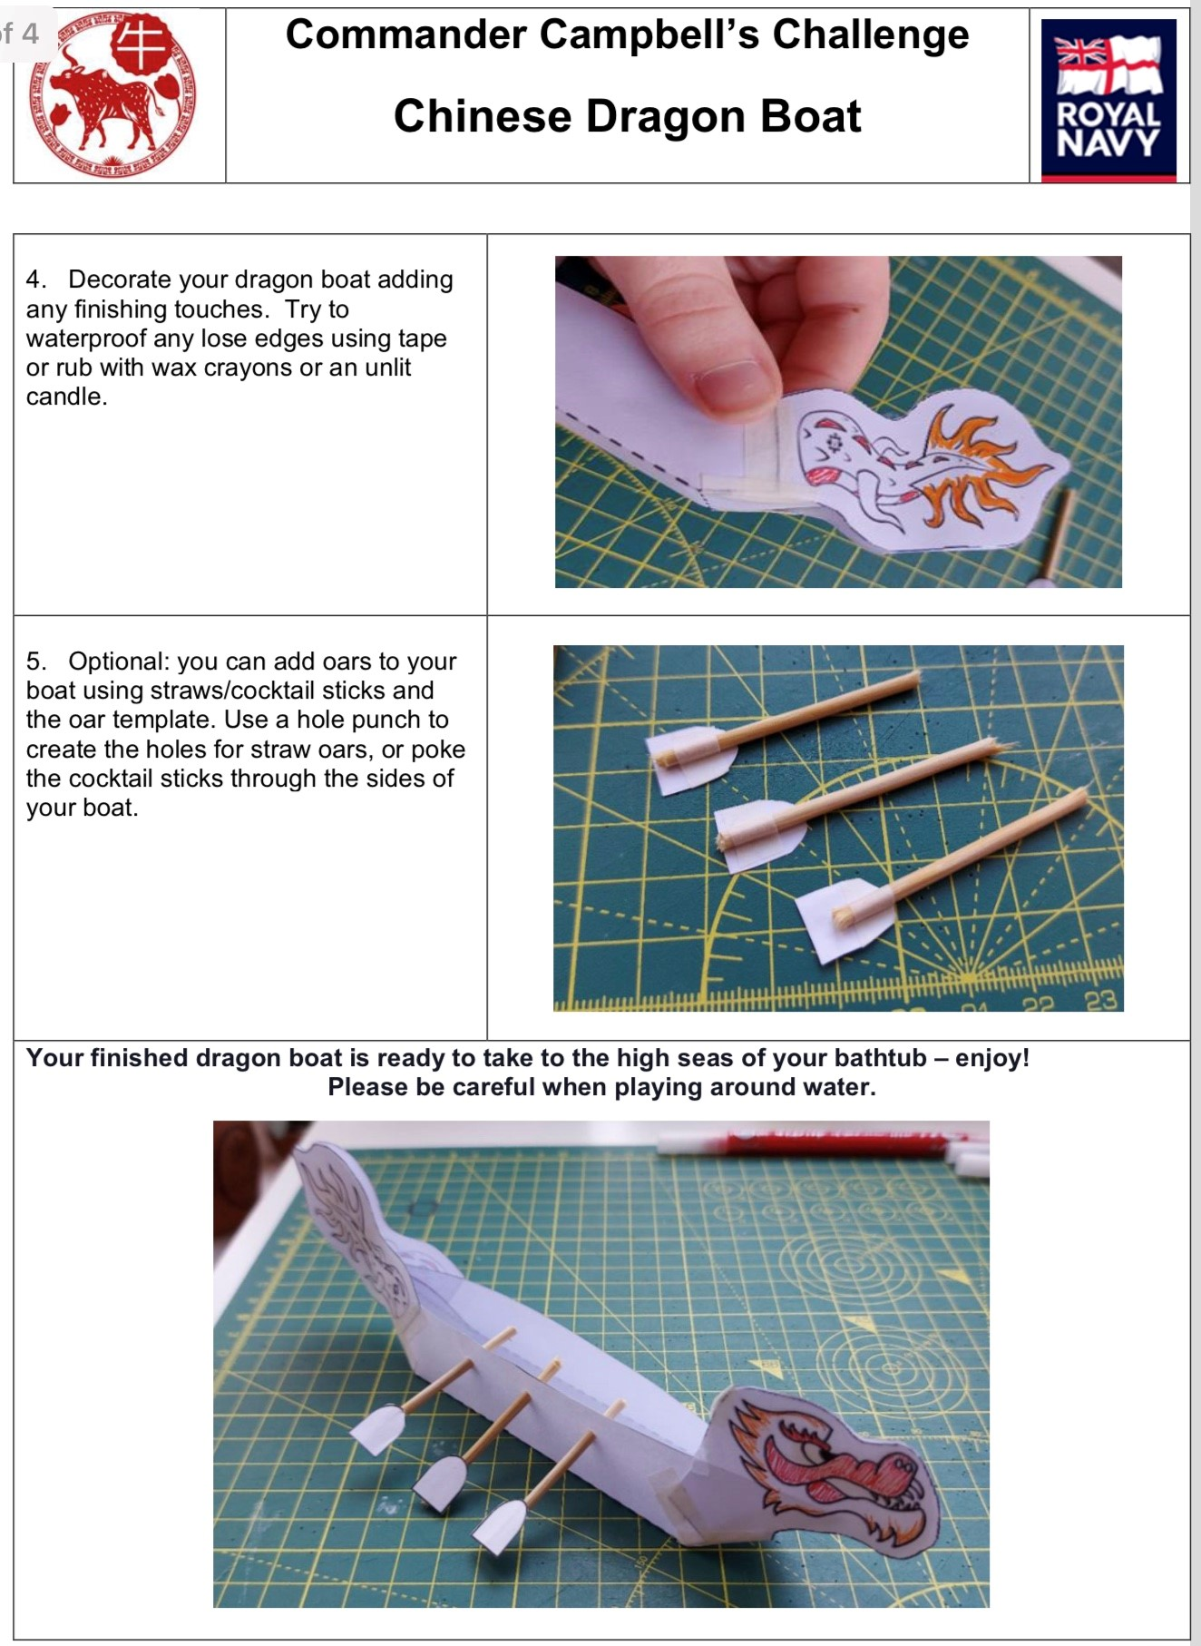
Royal Navy Dragon Boat Challenge

Slide 29
Royal Navy Dragon Boat Challenge

Slide 30
Royal Navy Dragon Boat Challenge

Slide 31
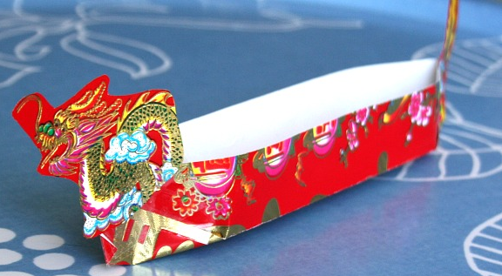
Royal Navy Dragon Boat Challenge
Don’t forget to tweet your designs to @CdrFCampbell

Slide 32
Good Bye Scouts 再見童子軍
zài jiàn tóng zǐ jūn

